Slide 1
Use Case Analysis
Chapter 5
PowerPoint Presentation for Dennis, Wixom, & Roth Systems Analysis and Design, 3rd Edition
Copyright 2006 © John Wiley & Sons, Inc. All rights reserved.
5 - ‹#›
Notes:
‹#›

Slide 2
Key Ideas
Use cases are a text-based method of describing and documenting complex processes
Use cases add detail to the requirements outlined in the requirement definition
Systems analysts work with users to develop use cases
Systems analysts develop process and data models later based on the use cases
PowerPoint Presentation for Dennis, Wixom, & Roth Systems Analysis and Design, 3rd Edition
Copyright 2006 © John Wiley & Sons, Inc. All rights reserved.
5 - ‹#›

Slide 3
Roles of Use Cases
document one or more functional requirements outlined in the requirements definition.
Explain and document the interaction that is required between the user and the system to accomplish the user’s task.
Help the development team understand more fully the steps that are involved in accomplishing the user’s goals.
Used to derive more detailed functional requirements for the new system.
PowerPoint Presentation for Dennis, Wixom, & Roth Systems Analysis and Design, 3rd Edition
Copyright 2006 © John Wiley & Sons, Inc. All rights reserved.
5 - ‹#›

Slide 4
Roles of Use Cases
A use case is a set of activities that produce some output result
Describes how the system reacts to an event that triggers the system
Trigger -- event that causes the use case to be executed
Event-driven modeling – everything in the system is a response to some triggering event
PowerPoint Presentation for Dennis, Wixom, & Roth Systems Analysis and Design, 3rd Edition
Copyright 2006 © John Wiley & Sons, Inc. All rights reserved.
5 - ‹#›

Slide 5
Role of Use Cases
All possible responses to the event are documented
Use cases are helpful when the situation is complicated
PowerPoint Presentation for Dennis, Wixom, & Roth Systems Analysis and Design, 3rd Edition
Copyright 2006 © John Wiley & Sons, Inc. All rights reserved.
5 - ‹#›

Slide 6
Elements of a Use Case
Basic information
Name, number and brief description
priority may be assigned to indicate the relative significance of the use case in the overall system
The actor refers a person, another software system, or a hardware device that interacts with the system to achieve a useful goal
Trigger – event that causes the use case to being
External trigger – some from outside the system
Temporal triggers – time-based occurrences
PowerPoint Presentation for Dennis, Wixom, & Roth Systems Analysis and Design, 3rd Edition
Copyright 2006 © John Wiley & Sons, Inc. All rights reserved.
5 - ‹#›

Slide 7
Elements of a Use Case
Preconditions define the state the system must be in before the use case commences.
Normal course - steps that are performed to execute the response to the event, the inputs used for the steps, and the outputs produced by the steps.
Alternative courses - depict branches in logic that would lead to a successful conclusion of the use case.
PowerPoint Presentation for Dennis, Wixom, & Roth Systems Analysis and Design, 3rd Edition
Copyright 2006 © John Wiley & Sons, Inc. All rights reserved.
5 - ‹#›

Slide 8
Elements of a Use Case
Postconditions define the final products of this use case, that may also serve as preconditions for the next use case in the series.
Exceptions - error conditions or exceptions that may occur as the use case steps are performed
Summary Inputs and Outputs, with their source or destination
PowerPoint Presentation for Dennis, Wixom, & Roth Systems Analysis and Design, 3rd Edition
Copyright 2006 © John Wiley & Sons, Inc. All rights reserved.
5 - ‹#›

Slide 9
Building Use Cases
PowerPoint Presentation for Dennis, Wixom, & Roth Systems Analysis and Design, 3rd Edition
Copyright 2006 © John Wiley & Sons, Inc. All rights reserved.
5 - ‹#›
Notes:
‹#›

Slide 10
Process of Developing Use Cases
Identify the major use cases
Identify the major steps within each use case
Identify elements within steps
Confirm the use case
Cycle through the above steps iteratively
PowerPoint Presentation for Dennis, Wixom, & Roth Systems Analysis and Design, 3rd Edition
Copyright 2006 © John Wiley & Sons, Inc. All rights reserved.
5 - ‹#›

Slide 11
Step 1: Identify the major use cases
Activities | Typical Questions Asked
Start a use case form for each use case If more than nine, group into packages of related usecases. (These packages are then treated as the major processes for the top level of the process model, with the use cases appearing on lower levels) | Ask who, what, and where about the tasks and their inputs and outputs: What are the major tasks performed? What triggers this task? What tells you to perform this task? What information/forms/reports do you need to perform this task? Who gives you these information/forms/reports? What information/forms/reports does this produce and where do they go?
PowerPoint Presentation for Dennis, Wixom, & Roth Systems Analysis and Design, 3rd Edition
Copyright 2006 © John Wiley & Sons, Inc. All rights reserved.
5 - ‹#›
Notes:
Identification of use cases begins with the requirements definition. The process-oriented functional requirements—things the system must do—suggest a direct action resulting from an external or temporal event.
Remember that a use case is a set of end-to-end activities that starts
with a trigger event and continues through many possible paths until some output has been produced and the system is again at rest.
‹#›

Slide 12
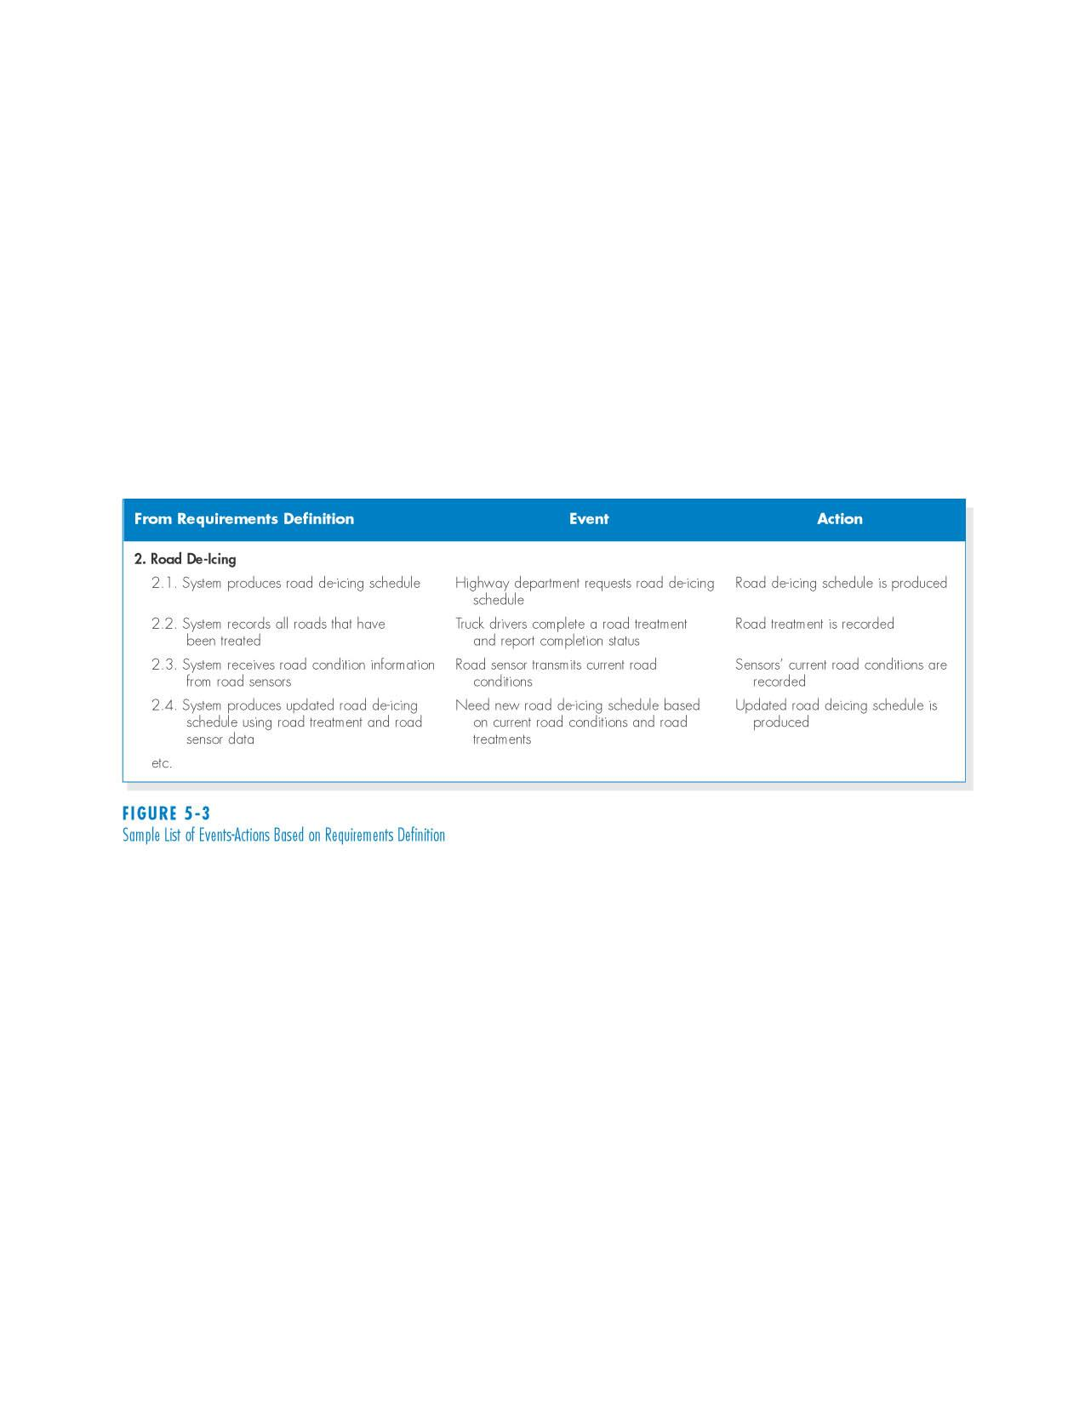
Sample List of Events-Actions Based on Requirements Definition
PowerPoint Presentation for Dennis, Wixom, & Roth Systems Analysis and Design, 3rd Edition
Copyright 2006 © John Wiley & Sons, Inc. All rights reserved.
5 - ‹#›

Slide 13
Step 2: Identify the major steps within each use case
Activities | Typical Questions Asked
For each use case, fill in the major steps needed to process the inputs and produce the outputs | Ask how about each use case: How do you produce this report? How do you change the information on the report? How do you process forms? What tools do you use to do this step (e.g., on paper, by email, by phone)?
PowerPoint Presentation for Dennis, Wixom, & Roth Systems Analysis and Design, 3rd Edition
Copyright 2006 © John Wiley & Sons, Inc. All rights reserved.
5 - ‹#›

Slide 14
Step 3: Identify elements within steps
Activities | Typical Questions Asked
For each step, identify its triggers and its inputs and outputs | Ask how about each step How does the person know when to perform this step? What forms/reports/data does this step produce? What forms/reports/data does this step need? What happens when this form/report/data is not available?
PowerPoint Presentation for Dennis, Wixom, & Roth Systems Analysis and Design, 3rd Edition
Copyright 2006 © John Wiley & Sons, Inc. All rights reserved.
5 - ‹#›

Slide 15
Step 4: Confirm the use case
Activities | Typical Questions Asked
For each use case, validate that it is correct and complete | Ask the user to execute the process using the written steps in the use case – that is, have the user role-play the use case
PowerPoint Presentation for Dennis, Wixom, & Roth Systems Analysis and Design, 3rd Edition
Copyright 2006 © John Wiley & Sons, Inc. All rights reserved.
5 - ‹#›

Slide 16
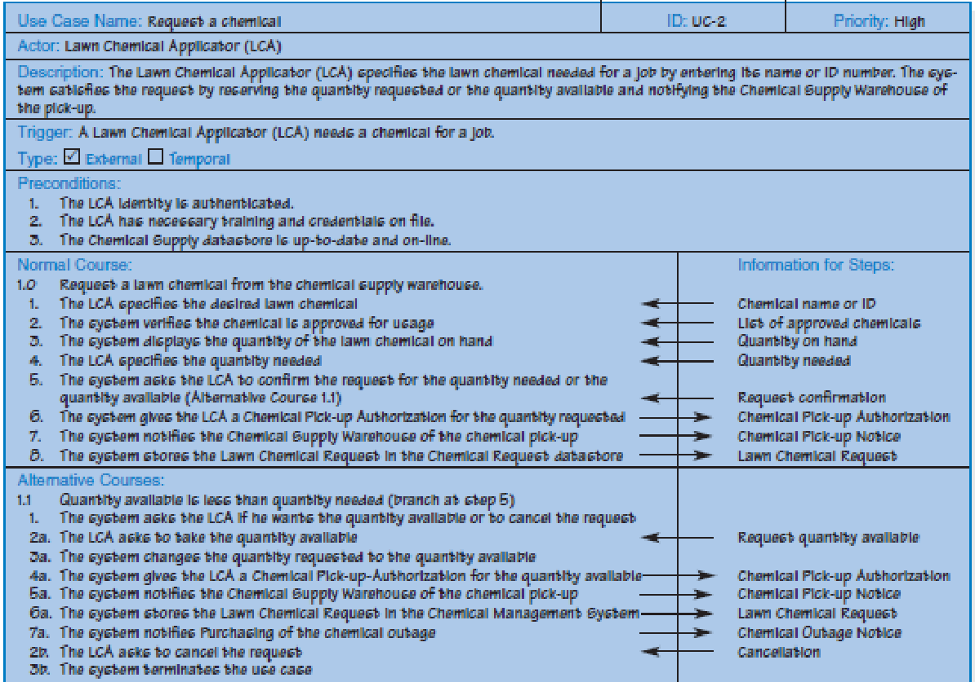
Example 1a: Request a Chemical Use Case
PowerPoint Presentation for Dennis, Wixom, & Roth Systems Analysis and Design, 3rd Edition
Copyright 2006 © John Wiley & Sons, Inc. All rights reserved.
5 - ‹#›
Notes:
This use case is based on the scenario of a lawn care company that employs specially trained workers to apply lawn chemicals (fertilizers and pesticides) to customers’ lawns. The company maintains a chemical supply warehouse where the employees obtain the needed chemicals for their lawn care assignments. The process of obtaining lawn chemicals involves
three main steps: authenticating the employee and ensuring he has the required training and credentials (a legal requirement for those who work with potentially dangerous materials such as pesticides); submitting a request for the needed chemical; and picking up the chemical from the chemical supply warehouse. The example use case focuses on the second step of this overall process: requesting a chemical.
‹#›

Slide 17
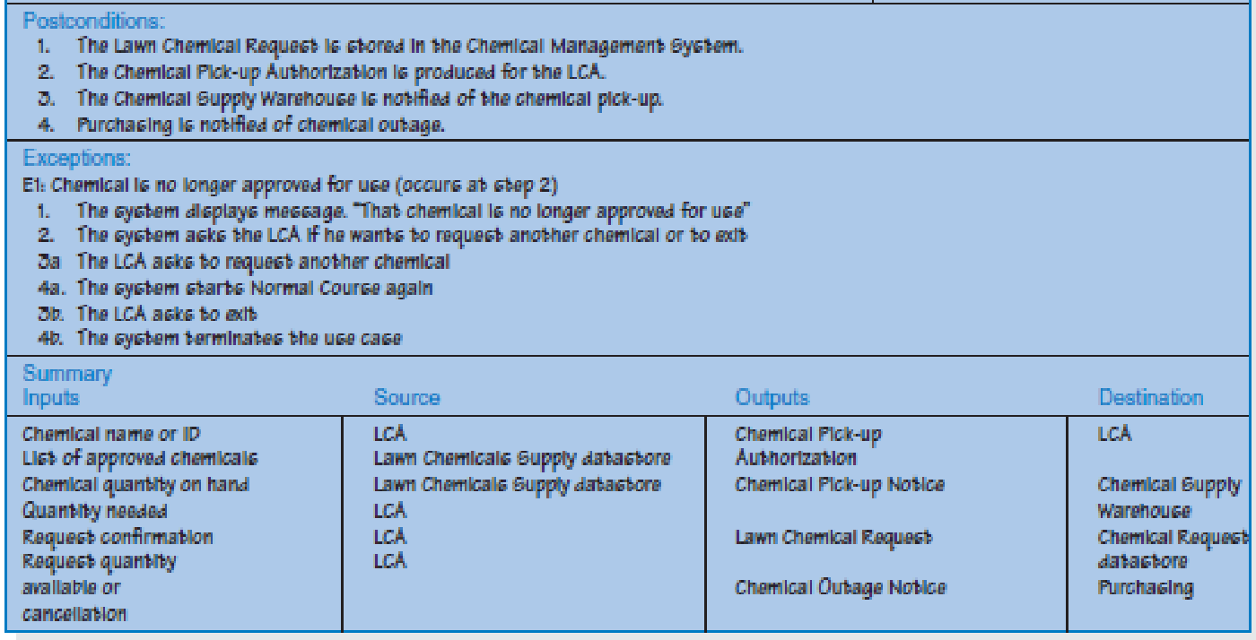
Request a Chemical Use Case cont.
PowerPoint Presentation for Dennis, Wixom, & Roth Systems Analysis and Design, 3rd Edition
Copyright 2006 © John Wiley & Sons, Inc. All rights reserved.
5 - ‹#›
Notes:
‹#›

Slide 18
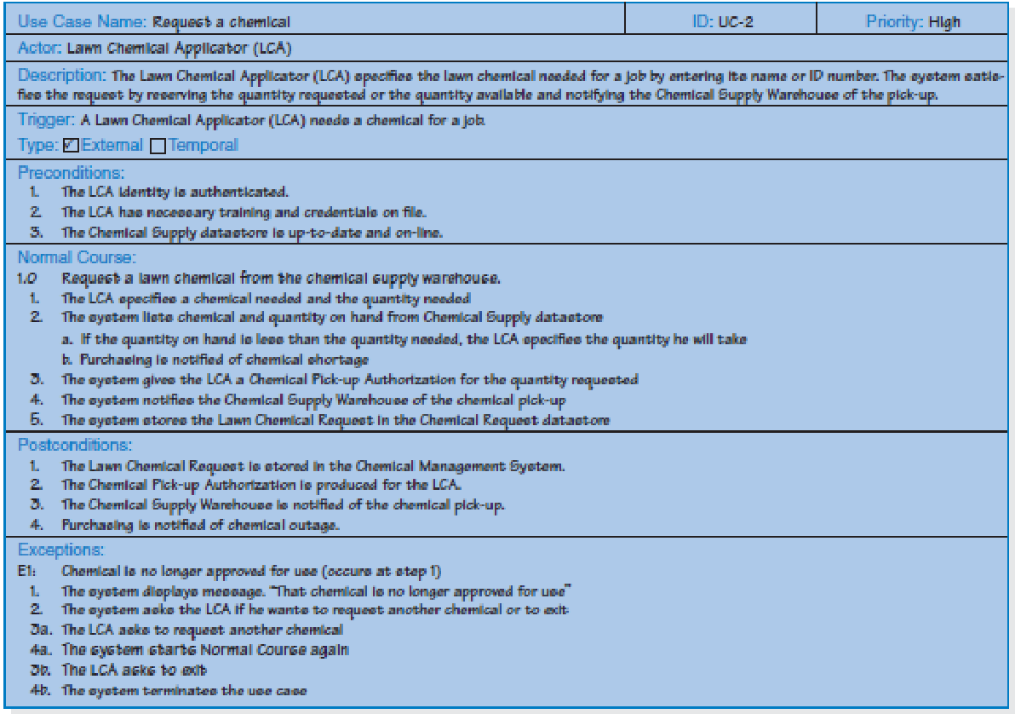
Example 1b: Request a chemical use case – casual format
PowerPoint Presentation for Dennis, Wixom, & Roth Systems Analysis and Design, 3rd Edition
Copyright 2006 © John Wiley & Sons, Inc. All rights reserved.
5 - ‹#›
Notes:
The project team may decide that a more casual use case format is acceptable. This format is less detailed. The essence of the user–system interaction is described, but with much less precision. It is important not to get too caught up in figuring out the “right” level of detail. Your focus should be on describing the user’s objectives in working with the system completely and accurately so that we will not have to rework the system later as it is being developed.
‹#›

Slide 19
Use Cases and the Functional Requirements
use cases are very helpful tools to use to understand user requirements.
However, they omit a lot of details that are necessary to know before the system can be developed.
System analyst needs to transform the user’s view into the developer’s view by creating functional requirements
The requirements give more information to the developer about what the system must do to allow the user to accomplish his goals.
PowerPoint Presentation for Dennis, Wixom, & Roth Systems Analysis and Design, 3rd Edition
Copyright 2006 © John Wiley & Sons, Inc. All rights reserved.
5 - ‹#›

Slide 20
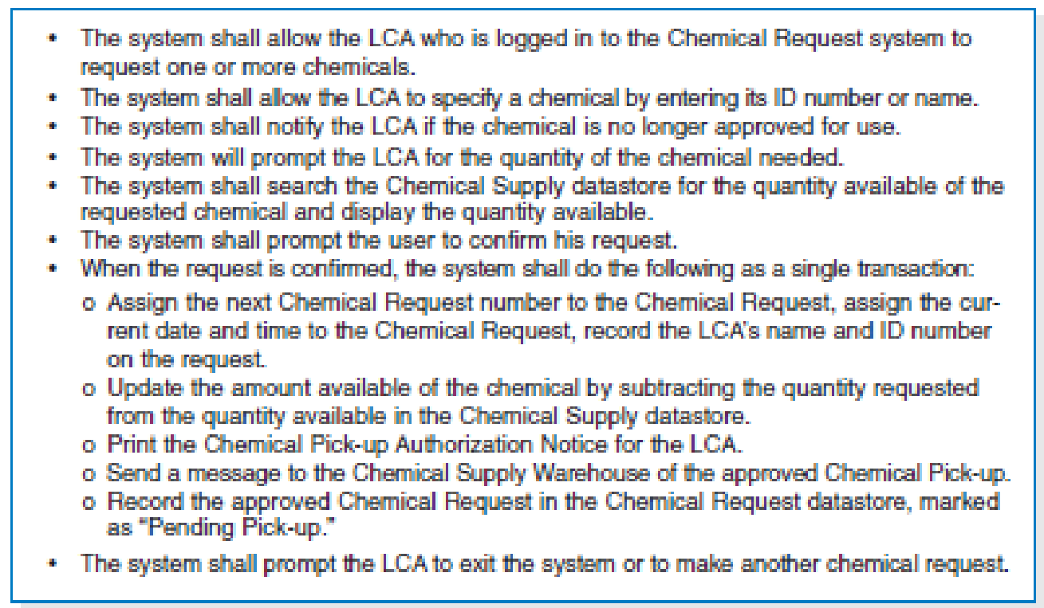
Request a chemical (Normal Course) Functional Requirements
PowerPoint Presentation for Dennis, Wixom, & Roth Systems Analysis and Design, 3rd Edition
Copyright 2006 © John Wiley & Sons, Inc. All rights reserved.
5 - ‹#›
Notes:
‹#›

Slide 21
Exercise 1
Read through the interview transcript for Holiday Travel Vehicles (HTV) scenario
Identify the major events that occur in the typical operations of HTV and represent this in an event/response table
The events suggest the primary things the users must accomplish with the system, and the responses describe the final results of the activities performed when the event occurs.
Identify and develop the major use cases in this case
PowerPoint Presentation for Dennis, Wixom, & Roth Systems Analysis and Design, 3rd Edition
Copyright 2006 © John Wiley & Sons, Inc. All rights reserved.
5 - ‹#›

Slide 22
Exercise 2
Identify and create a set of use cases for the dentist office system described below:
When new patients are seen for the first time, they complete a patient information form that asks for their name, address, phone number, and brief medical history, which are stored in the patient information file. When a patient calls to schedule a new appointment or change an existing appointment, the receptionist checks the appointment file for an available time. Once a good time is found for the patient, the appointment is scheduled.
PowerPoint Presentation for Dennis, Wixom, & Roth Systems Analysis and Design, 3rd Edition
Copyright 2006 © John Wiley & Sons, Inc. All rights reserved.
5 - ‹#›

Slide 23
Exercise 2 cont
If the patient is a new patient, an incomplete entry is made in the patient file; the full information will be collected when the patient arrives for the appointment. Because appointments are often made far in advance, the receptionist usually mails a reminder postcard to each patient two weeks before the appointment.
Now list the functional requirements associated with this case
PowerPoint Presentation for Dennis, Wixom, & Roth Systems Analysis and Design, 3rd Edition
Copyright 2006 © John Wiley & Sons, Inc. All rights reserved.
5 - ‹#›

Slide 24
Exercise 3
Identify and create a set of use cases for the online university registration system described below.
The system should enable the staff of each academic department to examine the courses offered by their department, add and remove courses, and change the information about them (e.g., the maximum number of students permitted). It should permit students to examine currently available courses, add and drop courses to and from their schedules, and examine the courses for which they are enrolled. Department staff should be able to print a variety of reports about the courses and the students enrolled in them. The system should ensure that no student takes too many courses and that students who have any unpaid fees are not permitted to register.
PowerPoint Presentation for Dennis, Wixom, & Roth Systems Analysis and Design, 3rd Edition
Copyright 2006 © John Wiley & Sons, Inc. All rights reserved.
5 - ‹#›

Slide 25
Summary
Use cases contain all the information needed for process modeling, but are easier for users to comprehend
Use cases are created in an iterative cycle of steps until they are considered accurate and complete
PowerPoint Presentation for Dennis, Wixom, & Roth Systems Analysis and Design, 3rd Edition
Copyright 2006 © John Wiley & Sons, Inc. All rights reserved.
5 - ‹#›

